Slide 1

UML Diagram
FALL2019
Lecture : UML Diagram

Slide 2
UML Diagram
UML stands for Unified Modeling Language which is used in object oriented software engineering.
It is a rich language that can be used to model an application structures, behavior and even business processes.

Slide 3
UML Diagram
UML divided into two main categories
Structure diagrams
Behavioral diagrams

Slide 4
List of UML Diagram Types
Class Diagram
Component Diagram
Deployment Diagram
Object Diagram
Package Diagram
Profile Diagram
Composite Structure Diagram
Use Case Diagram
Activity Diagram
State Machine Diagram
Sequence Diagram
Communication Diagram
Interaction Overview Diagram
Timing Diagram

Slide 5
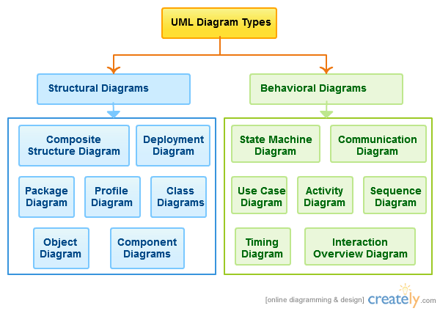

Slide 6
UML Diagram
Structure diagrams
show the things in a system being modeled.
In a more technical term they show different objects in a system.
Behavioral diagrams
shows what should happen in a system.
They describe how the objects interact with each other to create a functioning system.

Slide 7
Structure Diagram
Class Diagram
Class diagrams are arguably the most used UML diagram type.
It shows the classes in a system, attributes and operations of each class and the relationship between each class.
In most modeling tools a class has three parts, name at the top, attributes in the middle and operations or methods at the bottom.

Slide 8
Structure Diagram
Class Diagram
In large systems with many classes related classes are grouped together to create class diagrams.
Different relationships between diagrams are show by different types of Arrows.

Slide 9
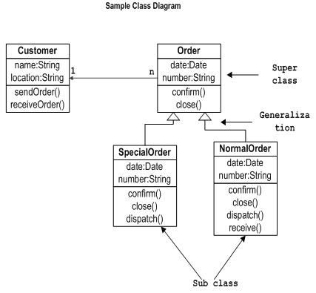
Class Diagram Example

Slide 10
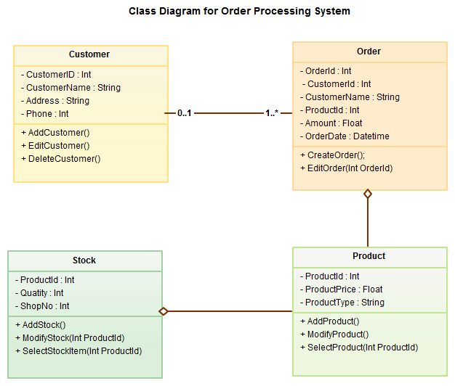
Class Diagram Example

Slide 11
Structure Diagram
Component Diagram
A component diagram displays the structural relationship of components of a software system.
These are mostly used when working with complex systems that has many components.
Components communicate with each other using interfaces.
The interfaces are linked using connectors. Below images shows a component diagram.

Slide 12
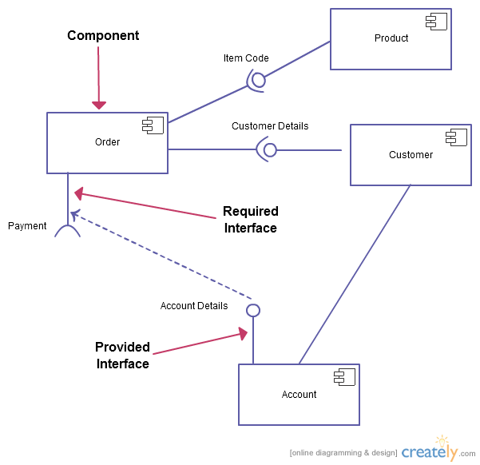
Component Diagram Example

Slide 13
Structure Diagram
Object Diagram
Object Diagrams, sometimes referred as Instance diagrams are very similar to class diagrams.
As class diagrams they also show the relationship between objects but they use real world examples.
They are used to show how a system will look like at a given time.
Because there is data available in the objects they are often used to explain complex relationships between objects.

Slide 14
Behavioral diagram
Use Case Diagram
Most known diagram type of the behavioral UML diagrams, Use case diagrams gives a graphic overview of the actors involved in a system.
Different functions needed by those actors and how these different functions are interacted.
It’s a great starting point for any project discussion because you can easily identify the main actors involved and the main processes of the system.

Slide 15
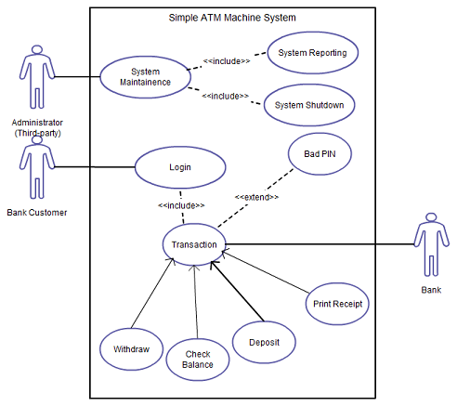
Use Case Diagram Example

Slide 16
Behavioral Diagram
Activity Diagram
Activity diagrams represent workflows in an graphical way.
They can be used to describe business workflow or the operational workflow of any component in a system.
Sometimes activity diagrams are used as an alternative to State machine diagrams.

Slide 17
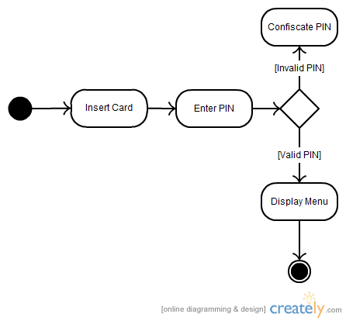
Activity Diagram Example

Slide 18
Behavioral Diagram
Sequence diagrams
shows how object interact with each other and the order those interactions occur.
It’s important to note that they show the interactions for a particular scenario. The processes are represented vertically and interactions are show as arrows.

Slide 19
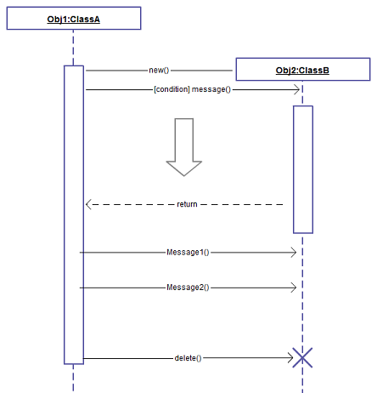
Sequence Diagrams Example
Notes:
http://creately.com/blog/diagrams/uml-diagram-types-examples/

Slide 20
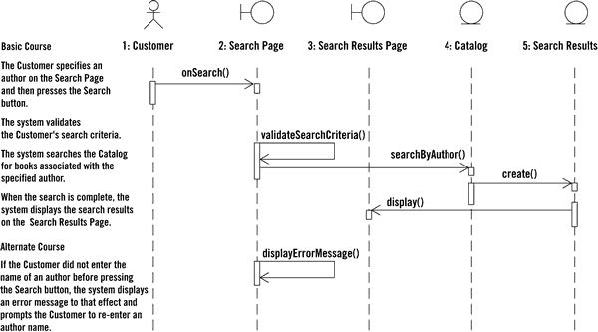
Sequence Diagrams Example

